Slide 1
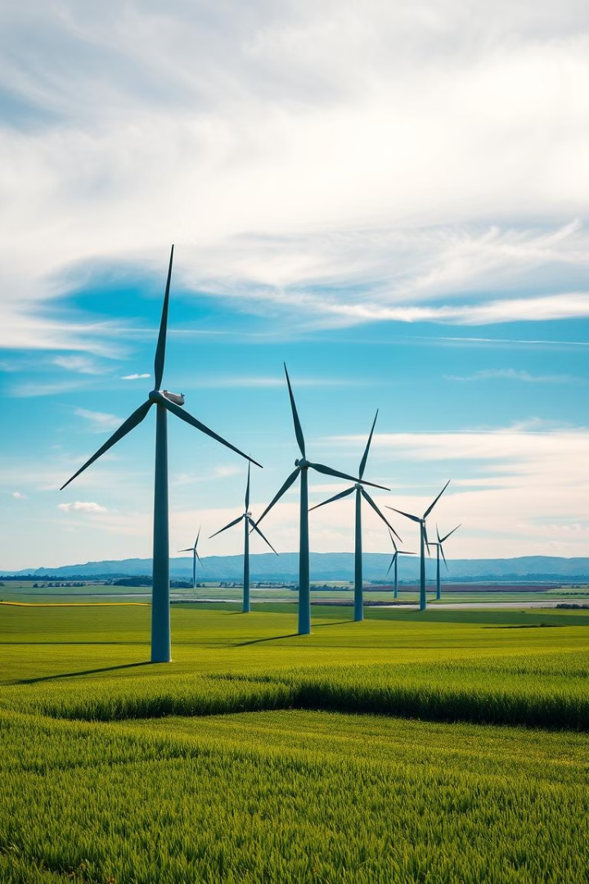

Environmental Monitoring with ESP32
This presentation explores environmental monitoring using the ESP32 module. We will discuss its importance and various applications. These include air quality monitoring, smart agriculture, and industrial safety. The global market is projected to reach $27.86 billion by 2029. Our focus is on cost-effective, real-time solutions.
by SIDDAMURTHI SURENDRA REDDY .

Slide 2
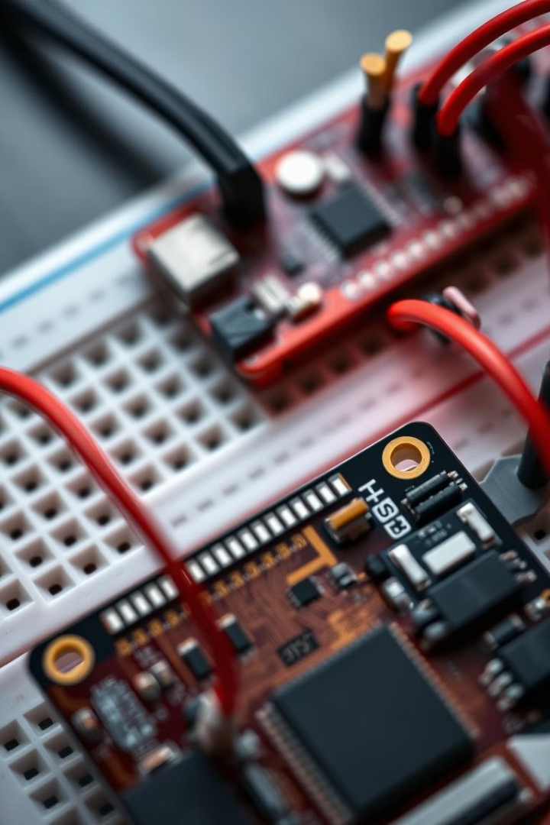



Hardware Components Overview
ESP32 Module
MQ-135 Gas Sensor
DHT11 Sensor
Features Wi-Fi, Bluetooth, and a dual-core processor.
Measures temperature and humidity accurately.
Detects ammonia, benzene, alcohol, and smoke.

Slide 3
Software Setup and Programming
Arduino IDE
Firmware
Install and configure the ESP32 board. Use the DHT sensor library. Include custom gas sensor calibration.
Program with C/C++. Establish Wi-Fi connectivity. Utilize data transmission protocols: HTTP, MQTT.

Slide 4
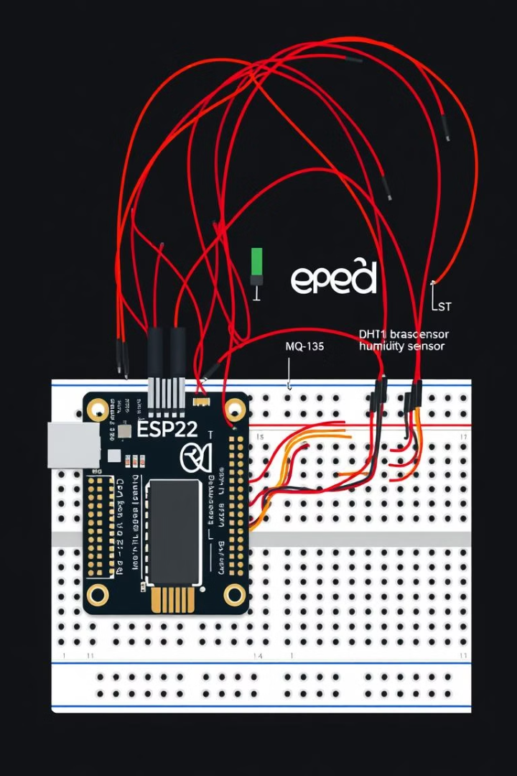


System Implementation and Wiring
DHT11
Data pin to ESP32 digital pin.
MQ-135
AOUT to ESP32 analog pin.
Connect sensors to ESP32. Read sensor values through ADC conversion. Calibrate for accuracy. Send data to a cloud platform via Wi-Fi.

Slide 5
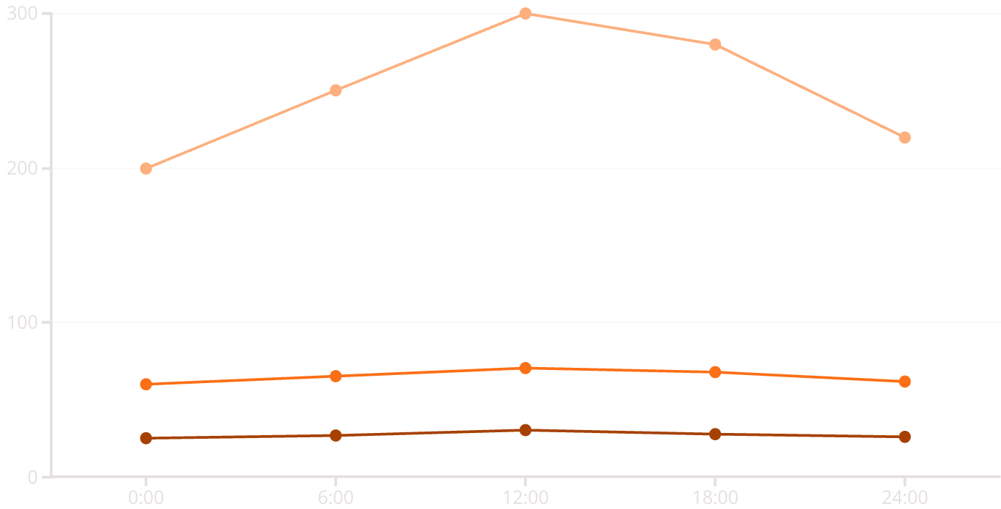
Data Analysis and Visualization
Temperature (°C)
Humidity (%)
Gas Concentration (ppm)
Configure cloud platforms. Visualize data trends over time. Calculate averages and set thresholds for critical levels. Log data in CSV format.

Slide 6
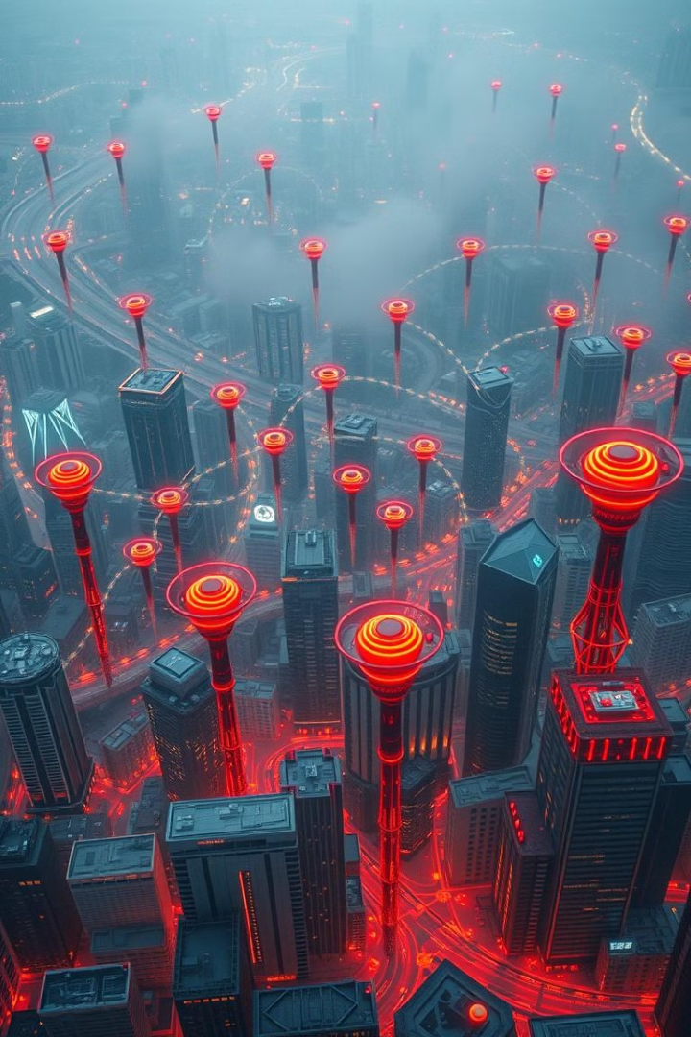
Case Studies and Applications
Air Quality Monitoring
Deploy in smart cities. Monitor pollution near schools.
Smart Agriculture
Monitor greenhouses for optimal plant growth.
Industrial Safety
Detect gas leaks in factories and chemical plants.
Bushfire Monitoring
Provide community awareness and safe work advice.

Slide 7
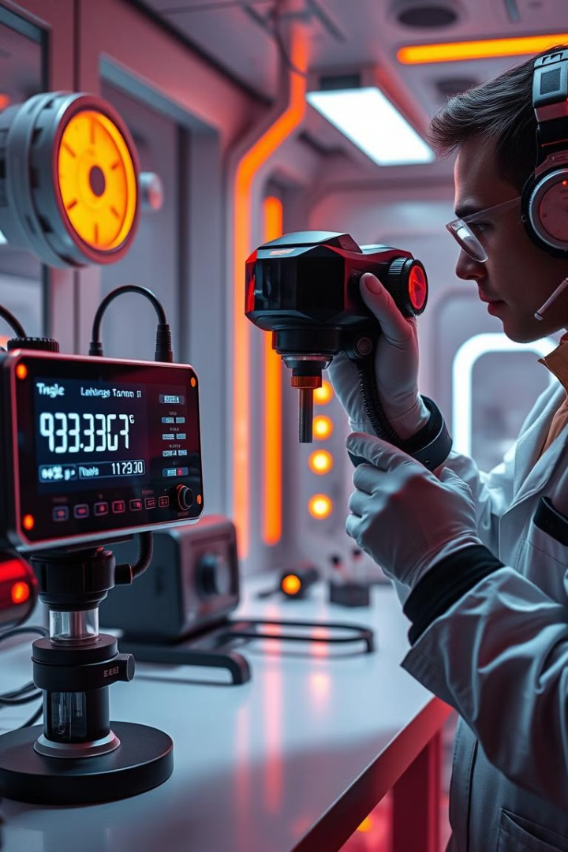
Challenges and Solutions
1
Sensor Drift
Implement calibration procedures.
2
Power Consumption
Use deep sleep mode.
3
Wireless Issues
Employ stable Wi-Fi.
4
Env. Factors
Shield from sunlight.

Slide 8
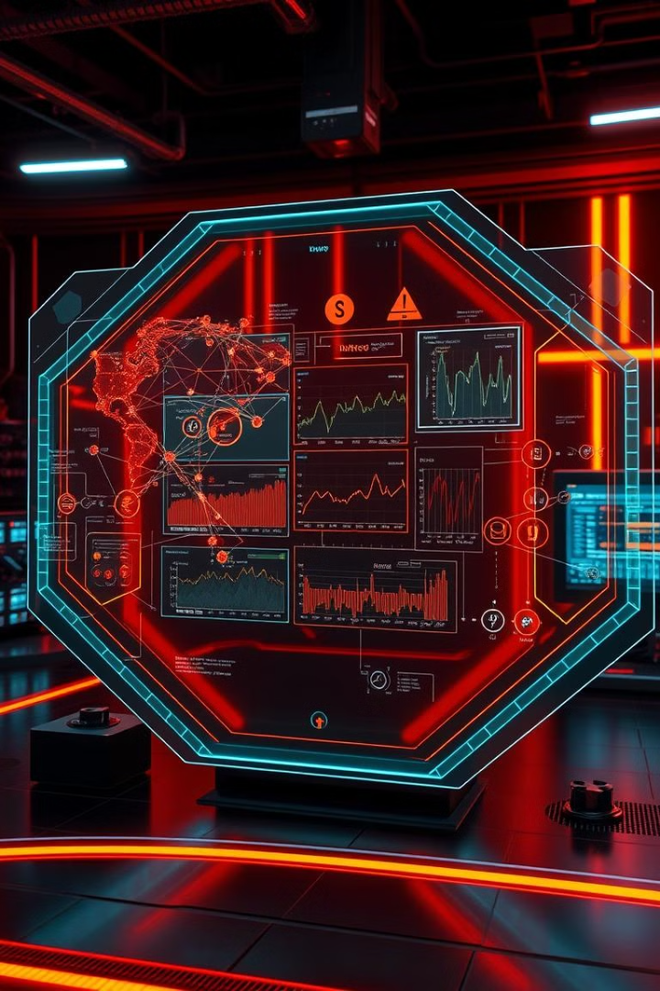
Conclusion and Future Scope
1
Project Summary
Low-cost, real-time environmental monitoring.
2
Future Enhancements
Add more sensors and machine learning.
3
Mobile App
Develop for remote monitoring and control.
4
Integration
Integrate with IoT platforms.

